Slide 1
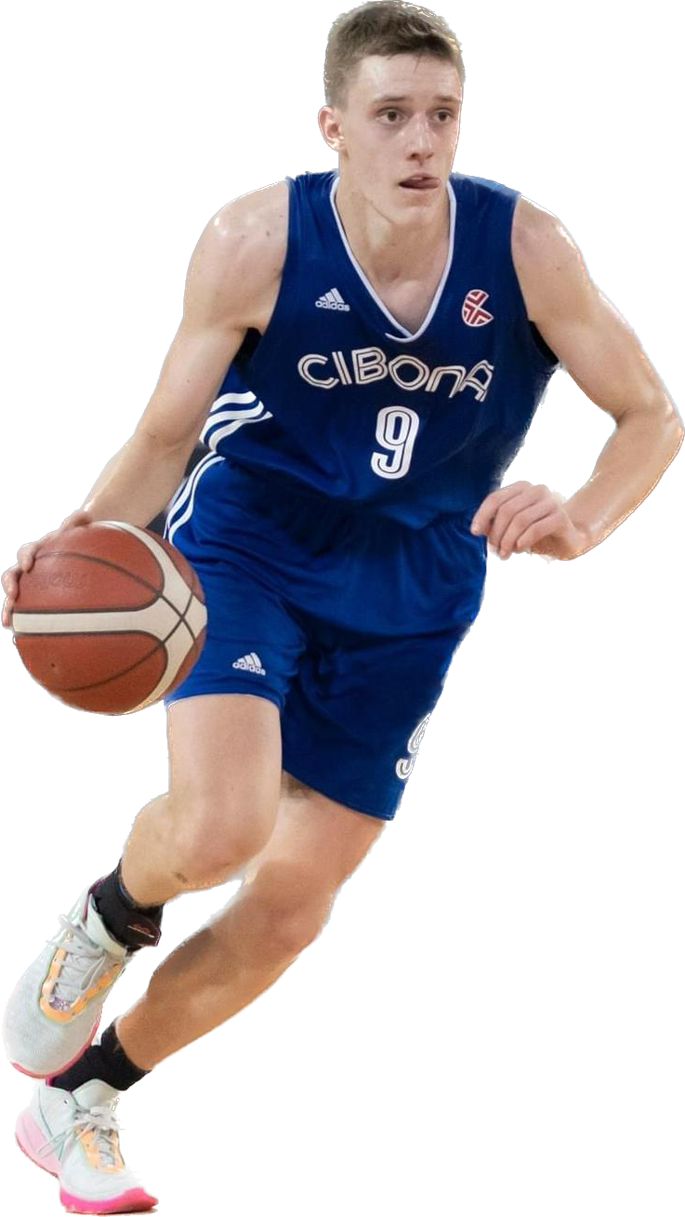
FILIP FERDERBER
STATISTICS
Age: 18
Gender : Male
Nationality : Croatia/Croatian
School Currently Attending : Gimnazija Benedikt Kotruljevic; Zagreb; Croatia
E-mail: filip.ferderber@icloud.com
Phone: +385 91 44 444 33
18
Games played
19.3
Points/game
2.2
Assists/game
ACADEMIC INFORMATION
7.0
Rebounds/game
Graduation Year : 2025
GPA: 3.9
Academic Interests: Physics, Mathematics
Dominant Hand:
Left
3.0
Steals/game
EXPERINCE
Team:
Basketball club CIBONA
Coach:
Marijan Bagarić
Coach contact :
+385989505354
0.2
Blocks/game
Born: 24 May 2006
From: Croatia, Zagreb
Height:
6’5”
Weight:
187 lb
Sports Awards:
2020_U15 National Championship_2nd place
2021_U17 National Championship_2nd place
2022_U17 National Championship_1st place
2023_U19 National Championship_2nd place
2024_U19 National Championship_3rd place
2024_SENIOR National Championship_3rd place
2024_SENIOR National Cup_2nd place
Camps/Training:
2021; U15 Croatian National Team Greece 3rd place
2022; U16 Croatian National Team EYOF 6th place
2023; U18 Croatian National team Camp
2024; IMG Academy Florida
2024; HoopGroup, Academic Elite Two, East Stroudsburg University
51.4%
Field Goal %
Primary Position:
Shooting Guard
Secondary Position:
Point Guard
80%
Free Throw %
Offensive Skills:
1. Three-point shooting
2. Dribble Penetration
3. ⁠Hi Basketball IQ - passing
Defensive Skills:
1. Deflections, Aggressiveness
2. Great anticipation in passing line to create steals
3. Excellent timing in rebounding
Personal Awards:
EYBL U17 Tournament Cluj; 2022 Romania – ALL STAR team
EYBL U17 Tournament Vienna; 2023 Austria – ALL STAR team
PH National Final4 Championship U19, Zadar 2024; Croatia, ALL STAR team
43.9%
Three-Point %
2.2
Turnovers/game
CONTACS
Parents: Zeljan Ferderber
E-mail: z.ferderber@me.com
Phone: +385 91 14 96 057

